Slide 1
Gamified Learning Platform for Rural Education Software
University Project
Review-2
Batch Number: CSE_171
Under the Supervision of,
Ms. Fathima Shana E
Assistant Professor
School of Computer Science and Engineering
Presidency University
Roll Number | Student Name
20221CSE0344 | THEJAS MAYUR S
20221CSE0345 | VINAY S
20221CSE0382 | MALLIKARJUN A S
Name of the Program: University Project
Name of the HoD: Dr. Asif Mohamed H B
Name of the Program Project Coordinator: Dr. Jayavadivel Ravi
Name of the School Project Coordinators: Dr. Sampath A K , Dr. Geetha A

Slide 2
Content
Abstract
Problem Statement
Literature Survey
Literature Survey Overview
Key Conclusions from Literature Survey
Existing Methods & Drawbacks
Objectives
System Architecture
Modules
Technology Stack Components
Innovation or Novel Contributions
GitHub Link
Timeline of the Project (Gantt Chart)

Slide 3
Abstract
Problem: Low STEM engagement in rural education
Objective: Improve learning through gamification
Solution: Gamified STEM learning platform
Approach: Research-driven design and modular architecture

Slide 4
Problem Statement Number: SIH-25048
Problem Description:
Rural students lack resources
Traditional teaching is not engaging
Different learning speeds are unsupported
Language barriers reduce understanding
Weak STEM concept clarity
Low performance, low interest

Slide 5
Literature Survey (10 Papers)
[1] Beronova: Designing an Offline Interactive Educational Mobile Game App for STEM Learning,” International Journal for Novel Research and Development (IJNRD), 2025.
[2] X. You and M. Sanmugam, “Literature Analysis on the Impact of Gamified Education on Engagement, Motivation, and Learning Outcomes among Rural Children in China,” J. Pendidikan Teknol. Informasi dan Komunikasi, vol. 3, no. 2, pp. 68–79, 2024.
[3] L. F. Dos Santos, W. Oliveira and J. Hamari, “The Effects of Ecological Gamification on Learners’ Engagement: A Quasi-Experimental Study,” in Proceedings of the 2024 IEEE International Conference on Advanced Learning Technologies (ICALT), pp. 8-9.

Slide 6
Literature Survey (10 Papers) Continued..
[4] S. Capecchi, A. Lieto, F. Patti, R. G. Pensa, A. Rapp, F. Vernero and S. Zingaro, “A Gamified Platform to Support Educational Activities about Fake News in Social Media,” IEEE Transactions on Learning Technologies, vol. XX, no. X, pp. 1–15, Apr. 2024, doi: 10.1109/TLT.2024.3410088
[5] P. Palee, “Interactive Learning Platforms and STEAM Education with Gamification,” Journal of Advanced Research in Technology and Innovation, 2024
[6] “Educational Games for Mobile Applications: A Systematic Literature Mapping” (Jonathan José Cardoso de Sales & Sandro Ronaldo Bezerra Oliveira), 2025

Slide 7
Literature Survey (10 Papers) Continued..
[7] A. Papadakis and M. Kalogiannakis,
“Using Gamification to Improve Students’ Learning in STEM Education: A Systematic Review,”IEEE Access, vol. 10, pp. 1–15, 2022.
[8] S. Barata, J. Gama, and D. Gonçalves,
“Improving Participation and Learning with Gamification,”
Proceedings of the IEEE International Conference on Advanced Learning Technologies (ICALT), 2021.
[9] A. Mora, D. Riera, C. González, and J. Arnedo-Moreno,
“Gamification: A Systematic Review of Design Frameworks,”
IEEE Global Engineering Education Conference (EDUCON), 2017.

Slide 8
Literature Survey (10 Papers) Continued..
[10] N. Z. Legaki, K. Xi, J. Hamari,
“The Effect of Challenge-Based Gamification on Learning,”
IEEE Transactions on Learning Technologies, 2020.

Slide 9
Literature Survey Overview
1. Multiple studies [1],[2],[8],[10] confirm that gamification significantly improves engagement and learning outcomes .
2. Personalised gamification has shown better effectiveness compared to generic approaches [3],[6],[10].
3. Challenge-based learning approaches outperform passive learning methods [1],[8],[10]
4. Gamified platforms are particularly effective for STEM education [1],[5],[7]

Slide 10
Literature Survey Overview
5. Simple and intuitive interfaces significantly improve usability and learner engagement [1],[4],[6].
6. Feedback mechanisms and reward systems play a key role in sustaining learner motivation [3],[8],[10].
7. Teacher supervision and performance analytics improve instructional effectiveness [1],[4],[5]
8. Context-aware and culturally relevant content increases learner engagement [2],[4],[6].
9. Long-term evaluation of learning outcomes is necessary to validate educational effectiveness [6],[8],[10].

Slide 11
Key Conclusions from Literature Survey
Gamification improves engagement and learning outcomes.
Personalised gamification is more effective than generic design.
Challenge-based learning outperforms passive learning.
STEM learning benefits from interactive games.
Simple UI improves usability and engagement.
Feedback, rewards, and progress tracking sustain motivation
Teacher monitoring improves learning effectiveness
Context-aware content increases rural learner participation
Performance tracking validates learning outcomes

Slide 12
Existing Methods & Drawbacks
Existing systems
Drawbacks
Designing an Offline Interactive Educational Mobile Game App for STEM Learning [1].
Literature Analysis on the Impact of Gamified Education on Engagement, Motivation, and Learning Outcomes among Rural Children in China. [2]
The Effects of Ecological Gamification on Learners . [3]
limited to Android devices only.[1]
Limited digital infrastructure in rural areas. The study focused only on preschool children [2].
No focus on rural or low-resource environments. [3]

Slide 13
Existing Methods & Drawbacks
Existing systems
Drawbacks
A Gamified Platform to Support Educational Activities about Fake News in Social Media.[4]
Interactive Learning Platforms and STEAM Education with Gamification . [5]
Educational Games for Mobile Applications: A Systematic Literature Mapping [6]
Focused only on fake news education, not STEM subjects. [4]
Focused mainly on teacher education, not school students [5]
Lack of standardization in educational game development.[6]

Slide 14
Existing Methods & Drawbacks
Existing systems
Drawbacks
Using Gamification to Improve Students’ Learning in STEM Education . [7]
Improving Participation and Learning with Gamification . [8]
Gamification: A Systematic Review of Design Frameworks . [9]
The Effect of Challenge-Based Gamification on Learning [10]
Focused only on science, not full STEM[7]
Focused only on college-level education [8]
No direct system or platform implementation[9] .
Limited to academic classroom settings [10]

Slide 15
Objectives
Gamified Learning Platform
STEM Education
Interactive Game-Based Learning
Multilingual Content, Regional Language Support
Student Progress Tracking
Learning Analytics , Scores & Performance
Rewards & Levels
Improved Learning Outcomes

Slide 16
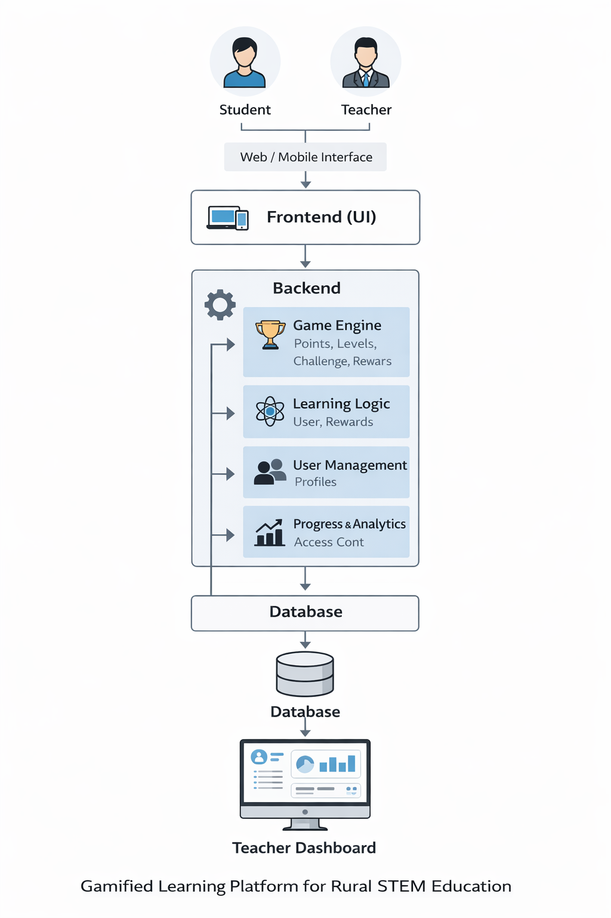
System Architecture

Slide 17
Modules
User Management
Game Engine
Learning Logic
Progress & Analytics

Slide 18
Technology Stack Components:
Frontend (Student & Teacher Interface)
HTML, CSS, JavaScript
Backend (Application Logic)
Python (Flask / FastAPI)
Database
PostgreSQL
Gamification Engine
Score, levels, badges, rewards logic
Content Management System
Stores STEM lessons, quizzes, and games
Multilingual Support
Language translation (Google Translator API)

Slide 19
Innovation or Novel Contributions
Gamification-based STEM Learning
Multilingual Learning Support
Student Progress Tracking and Rewards
Rural-Focused Digital Education Platform

Slide 20
Github Link
The Github link provided should have public access permission.
Github Link:
https://github.com/vinay18082004/University_project_CSE_171.git

Slide 21
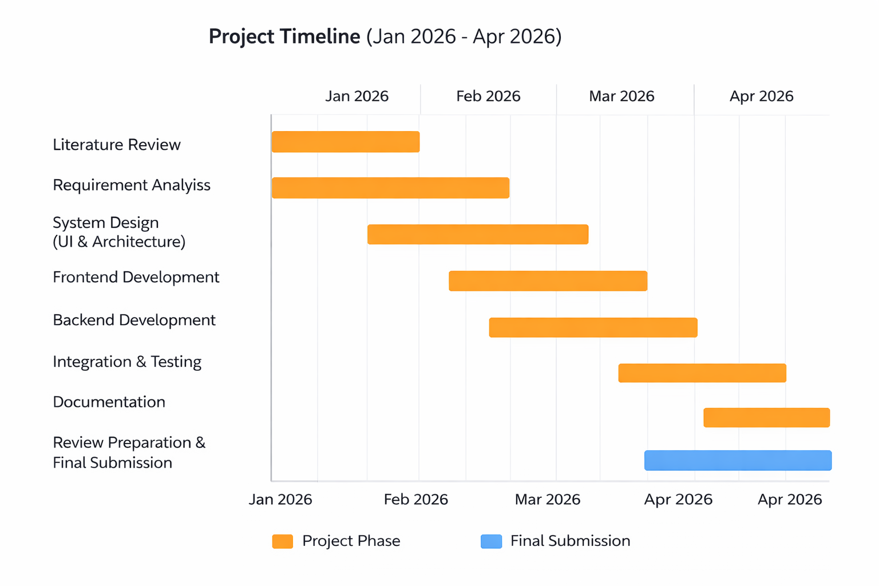
Timeline of the Project (Gantt Chart)

Slide 22


